Slide 1
Role of Merchant Banks in new issue
Merchant Banks
Public Sector
Private Sector
International Banks
Commercial Banks
Private Sector
Financial Institutions
Financers & Investors
State Institutions
Total of 211
Merchant Bankers are registered with SEBI as of now
Ashish Gokarnkar
18IM30027
Source: sebi.gov.in/sebiweb/other/OtherAction.do?doRecognisedFpi=yes&intmId=9

Slide 2
Categorization
C1
C2
C3
C4
Issue Manager | Advisor
Book Underwriter | Consultant
Portfolio Manager
Lead
Manager
Book Underwriter | Advisor
Portfolio Manager | Consultant
Co -
Manager
Book Underwriter | Advisor | Consultant
Price Band Advisor
Advisor | Consultant
Document Processor
Source: http://lawtimesjournal.in/merchant-banking-in-india/
Notes:
http://lawtimesjournal.in/merchant-banking-in-india/

Slide 3














Example: MindSpace REIT IPO
* DSP Merrill Lynch
13
Merchant Bankers
All of them = LEAD
Registrar
Source: https://www.bseindia.com/downloads/ipo/20201319346MBP_Reits_03012020.pdf
Notes:
http://lawtimesjournal.in/merchant-banking-in-india/

Slide 4
Pre – Issue Obligations
Furnish * Due Diligence Certificate to SEBI
Dispatch of Issue Material
MoU – Issuer & Lead Merchant Banker
* Offer Document → DRHP
Estimated IPO size
#shares being offered to public
Why IPO? And where shall funds go?
Submit Undertaking
Submit List of Promoters and their shareholdings
Appointment of Co-managers and other Intermediaries
Business description
Complete financial statements
Management Discussion & Analysis
Risks involved in the business
Sources: https://www.sebi.gov.in/guide/guide20005.html
https://zerodha.com/varsity/wp-content/uploads/2015/04/module1.pdf
Notes:
https://www1.nseindia.com/emerge/participants/content/sme_merch_roles.htm

Slide 5
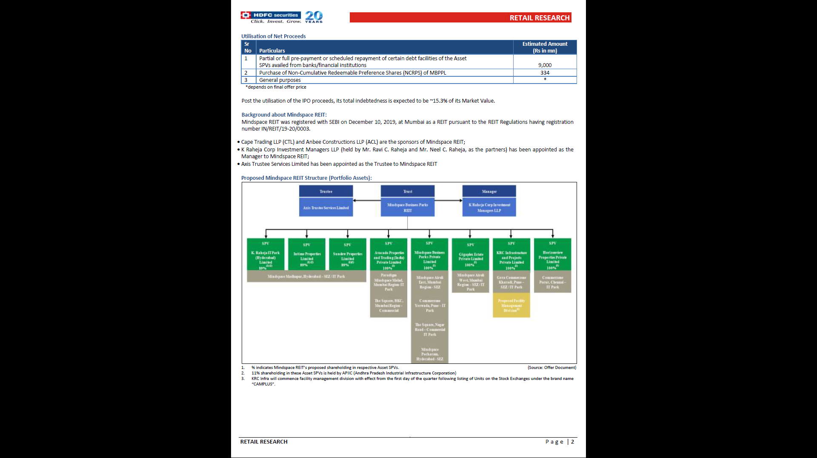
Example: MindSpace Due Diligence
Done by
Contents
Background
Net Proceeds Utilization
Internal Asset Portfolio
Client + Supplier Study
Industry Comparison
Business Risks
Financials
Investor Consensus
Source: hdfcsec.com/hsl.docs//IPO%20note%20-%20Mindspace%20REIT.pdf
Notes:
https://www1.nseindia.com/emerge/participants/content/sme_merch_roles.htm

Slide 6
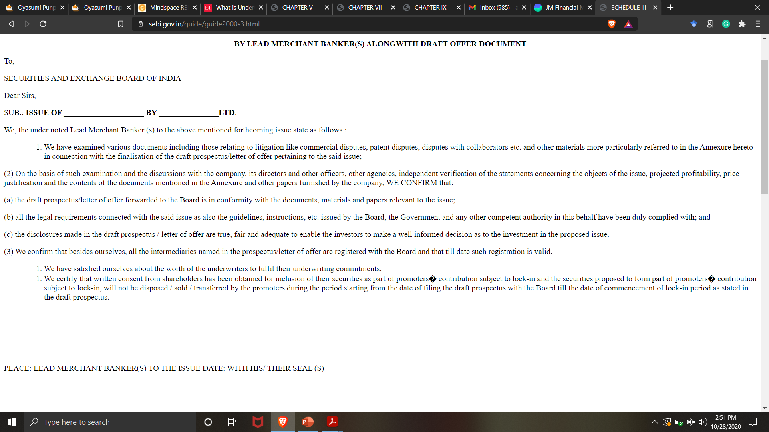
Example: Due Diligence Certificate
SEBI pre-defined Letterhead + Annexure
MoU
Govt. Clearance
StockEx Listing Agreement
Banker Consent Letters
Underwriter Addressal
Minutes of Board Meeting
Environmental Clearance
by PCB
RBI Approval
Auditor Clearance
Annexure
Source: https://www.sebi.gov.in/guide/guide2000s3.html
Notes:
https://www1.nseindia.com/emerge/participants/content/sme_merch_roles.htm

Slide 7
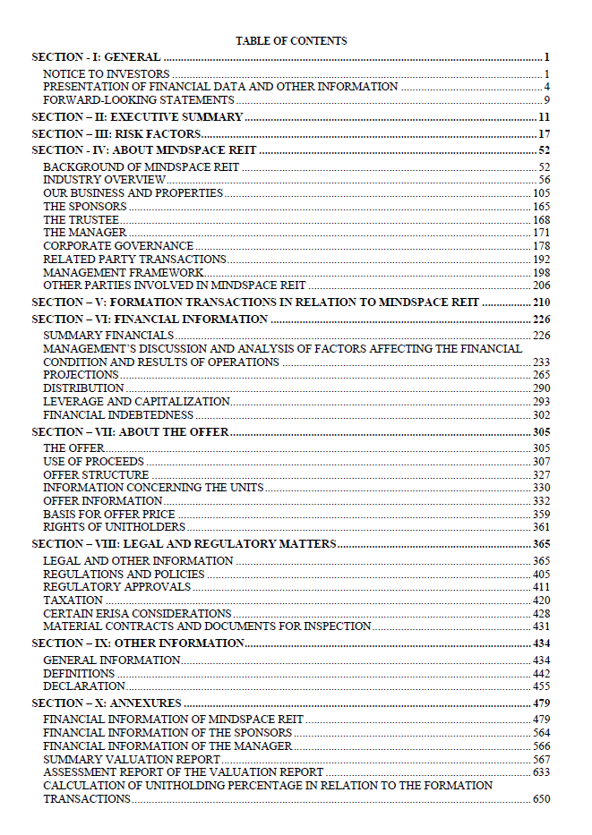
Example: MindSpace Offer Document
Key Contents
Risk Factors
Corporate Structure
Financial Statements
Offer Proceeding
Use of Money
Price Ranges
Regulation Bindings
Overall 674 Pages
Source: investmentbank.kotak.com/mindspace-business-parks-reit-final-offer-document.pdf
Notes:
https://www1.nseindia.com/emerge/participants/content/sme_merch_roles.htm

Slide 8
Post – issue Obligations
* Post-issue monitoring reports : 3-Day & 78-Day
* Redressal of Investor Grievances
Underwriters: If the issue is proposed to be closed at the earliest closing date, the lead Merchant Banker shall satisfy himself that the issue is fully subscribed before announcing closure of the issue.
Stock Invest Compliance as per RBI mandates
Payment of interest for delayed dispatch
Allotment letters
Ensure money received from the issue is kept in a separate bank
Post – issue advertisement
Subscription Status
Refund Orders, etc.
# (value) and % of applications
Basis of allotment
Dates
Source: https://www.sebi.gov.in/guide/guide20007.html
Notes:
https://www1.nseindia.com/emerge/participants/content/sme_merch_roles.htm

Slide 9
Post Issue Monitoring Reports Reports
Responsibility of Post – Issue Lead Merchant Bankers of Issuer
Subscription Status | Oversubscribed/ Undersubscribed
Closing Dates | Earliest + Actual
Issue Details | Nature of Instruments (Equity/FCD/PCD/NCD/Others, etc.) Offer Price of Instruments
Issue Size | Promoters Contribution + Net Public Offer
Subscription Details | Total amount to be collected on application Amount Collected on application % subscription Amount subscribed by reserved category on reserved basis
Has 90% minimum subscription of the amount through offer document been collected ? | YES/ NO
Signature | Registrar/ Lead Merchant Banker
78-Day
# Underwriters
Investor Grievances
Source: https://www.sebi.gov.in/guide/guide2000s16.html
Notes:
https://www1.nseindia.com/emerge/participants/content/sme_merch_roles.htm

Slide 10
SEBI Norms: Redressal of Investor Grievances
Sr. No. | Activity | Timeline #days
1.A | Complaint Arrived | T
B | Response required | < T + 30
C | Else Alert Issuer | T + 31
D | Response required | < T + 60
2.A | Else Fine@ ₹1000/day/complaint | T + 61
B | Final Notice to promoters | T + 76
C | Freezing of promoter shareholdings | T + 86
Applicable for Non-receipt of (in IPOs)
Refund in Public Issue
Shares after Transfer
Receipt in Physical Mode instead of electronic mode
Elsewise
Bonus
Dividend
Interest
Source: https://www.sebi.gov.in/guide/guide20007.html
Notes:
https://www1.nseindia.com/emerge/participants/content/sme_merch_roles.htm

Slide 11

Guidance on Advertisement
Lead Merchant Banker shall ensure compliance with the guidelines on Advertisement by the issuer
MoU that the issuer company shall not directly or indirectly release, during any conference or at any other time, any material or information which is not contained in the offer documents.
Ensure that the issuer company obtains approval in respect of all issue advertisements and publicity materials
Inaccurate portrayal of past performance
Verify that issue advertisement shall be truthful, fair and clear and shall not contain any statement which is untrue or misleading.
Complex language
Profit guarantee
Models, celebrities, fictional characters, landmarks or caricatures
Source: https://www.sebi.gov.in/guide/guide20009.html
Notes:
https://www1.nseindia.com/emerge/participants/content/sme_merch_roles.htm

Slide 12

Example: Allocation of Responsibilities
Due Diligence
Finalizing various agreements
underwriting
offering
syndicate
escrow
IPO Instrument Design
Compliance with Regulatory Authorities
Rebase financial forecasts
Auditor Clearance
Appointment and coordination b/w
Completion of the formation transactions
Allotment of Shares
International Institutional Marketing of the Offer
International Marketing Strategy
International Roadshow
Sourcing International Investors
Valuer
Registrar
Bankers
Industry Expert
Printers
Advertising agency
Source: investmentbank.kotak.com/mindspace-business-parks-reit-final-offer-document.pdf
Notes:
https://www1.nseindia.com/emerge/participants/content/sme_merch_roles.htm

Slide 13
Example: Allocation of Responsibilities
Coordination with stock exchanges for Book Building software and submitting 1% deposit
Finalizing the Anchor Minutes and Strategic Investor minutes
Managing the book
Finalizing of pricing
Post bidding activities
Domestic Institutional Marketing of the Offer
Domestic Marketing Strategy
Domestic Roadshow
Finalizing list and divisions of domestic investors
Non-Institutional marketing strategy
Finalizing Collection Centers
Finalizing Brokerage and Commission
Preparation of publicity budget, finalizing media, marketing and public relations strategy
Management of escrow accounts
Finalization of basis of allotment
Dispatch of allocation letters & refund to Bidders
Obtaining relevant listing approvals
Source: investmentbank.kotak.com/mindspace-business-parks-reit-final-offer-document.pdf
Notes:
https://www1.nseindia.com/emerge/participants/content/sme_merch_roles.htm

Slide 14
Summary: Roles & Responsibilities
Educating the applicant company
Due diligence & DRHP Preparation
Display of offer document on website
Market Making arrangement
Underwriting arrangement
Arrangement with nominated investors
Source: https://www1.nseindia.com/emerge/participants/content/sme_merch_roles.htm
Notes:
https://www1.nseindia.com/emerge/participants/content/sme_merch_roles.htm

Slide 15
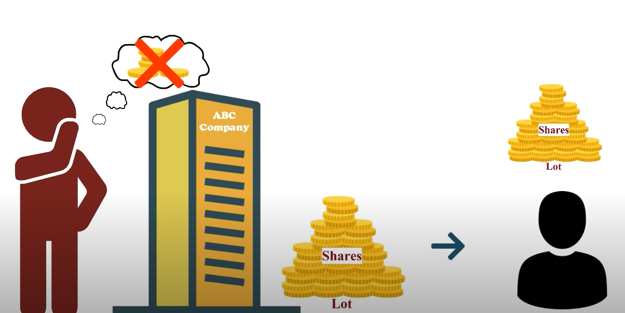
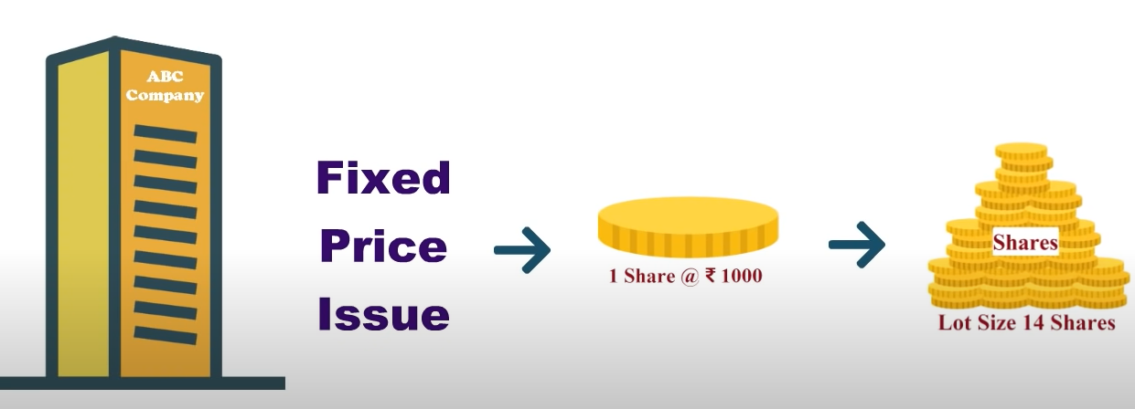

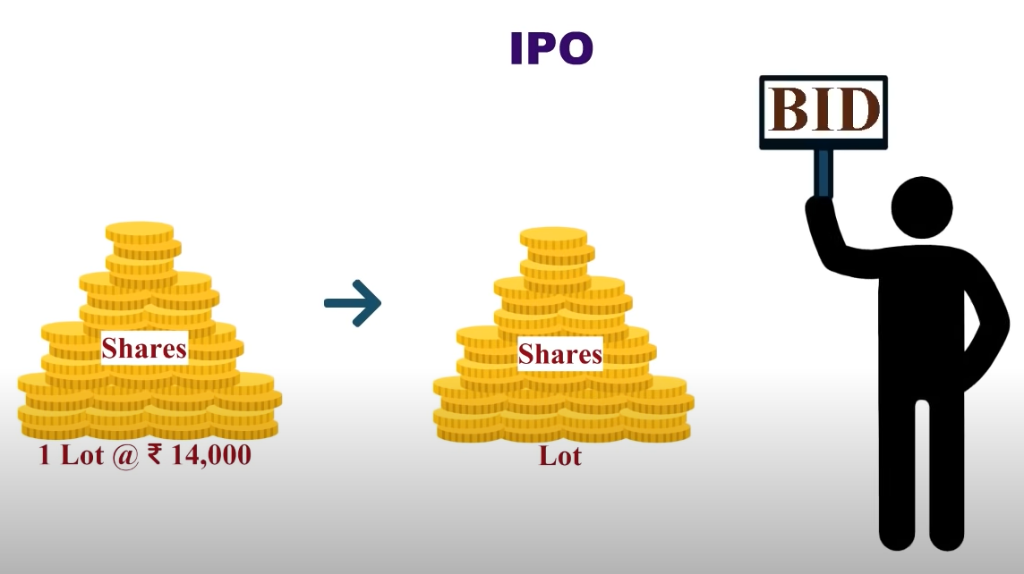
Registrar & IPO allotment : Ankit Pandey (17MF3FP18)
(My explanation)

Slide 16
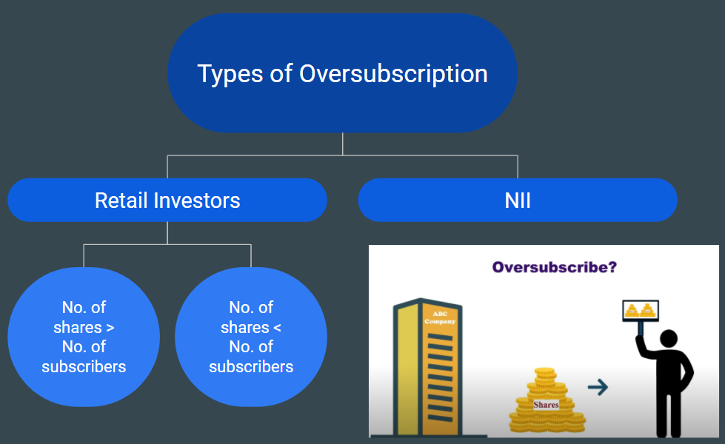
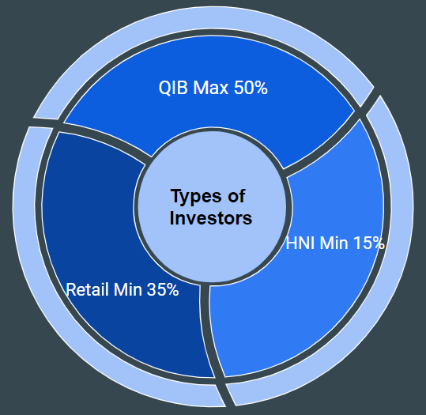

Slide 17
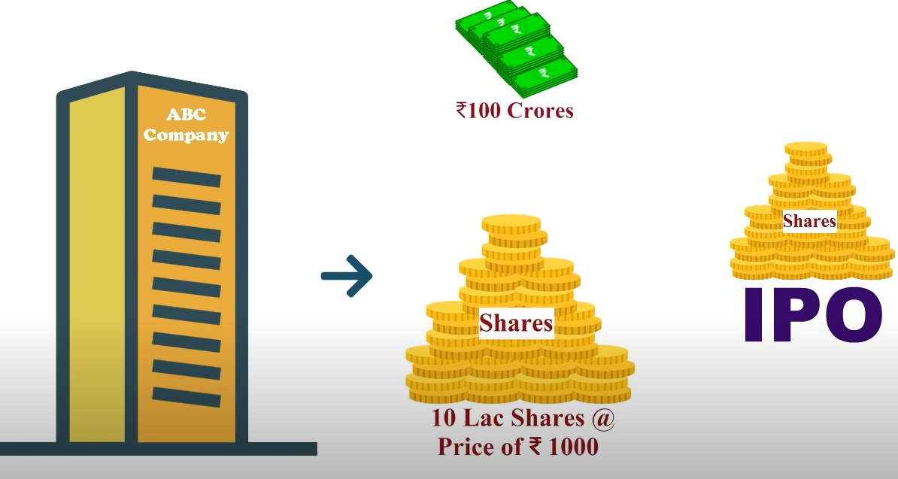
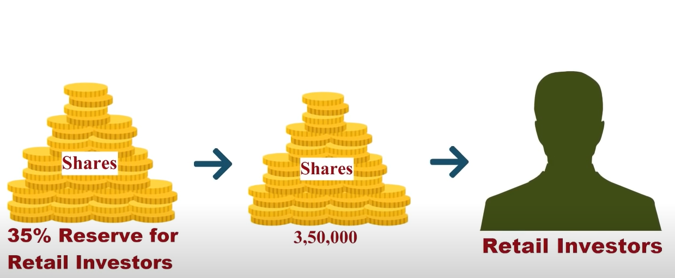
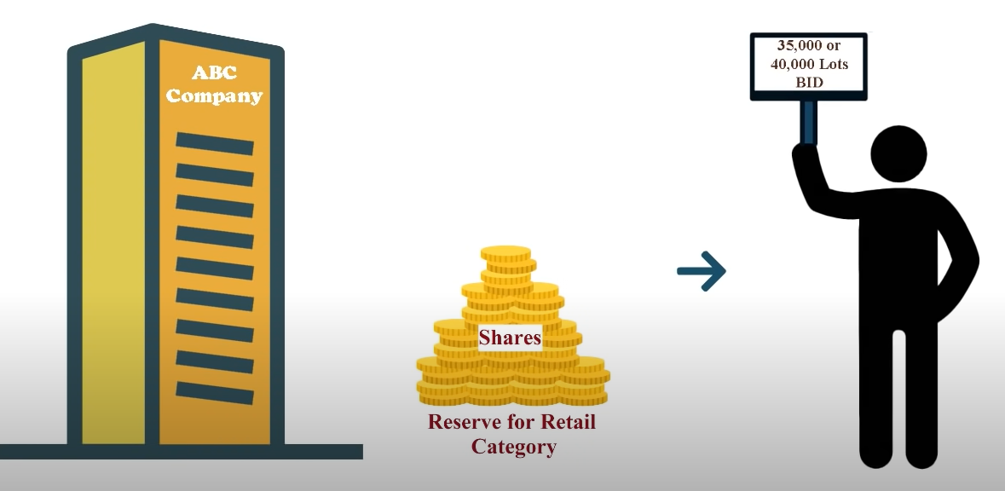
Retailer Investors Case 1

Slide 18
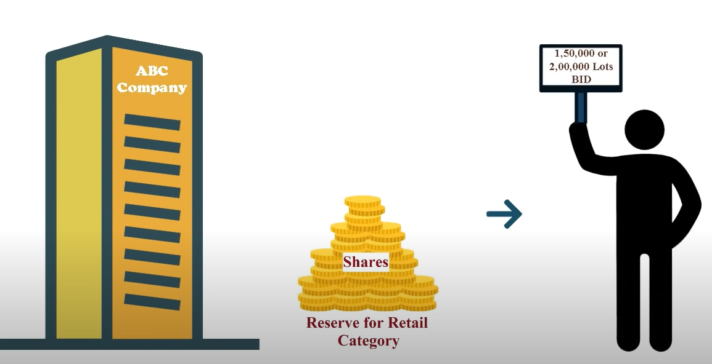
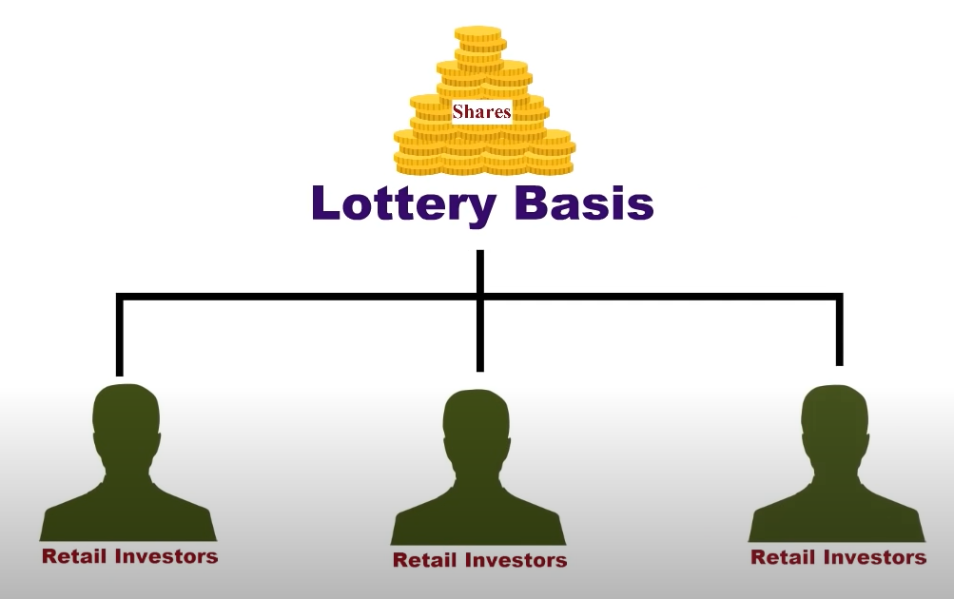
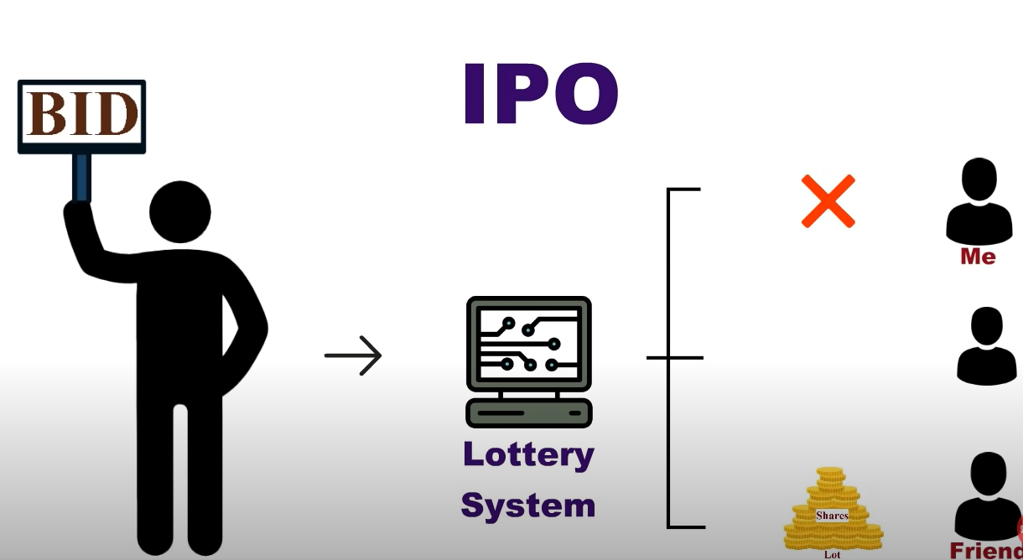
Retailer Investors Case 2

Slide 19
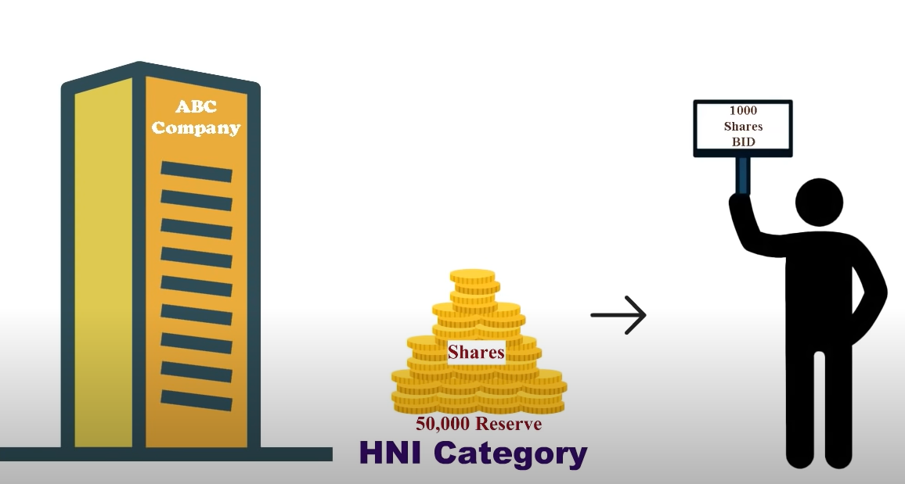
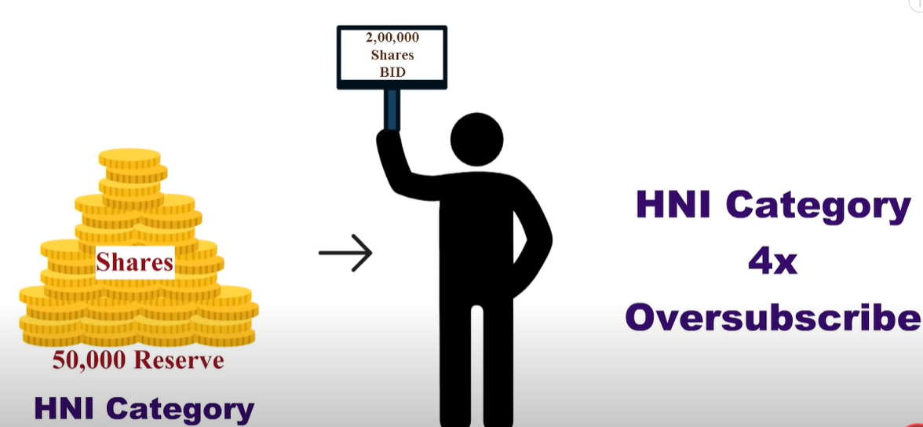
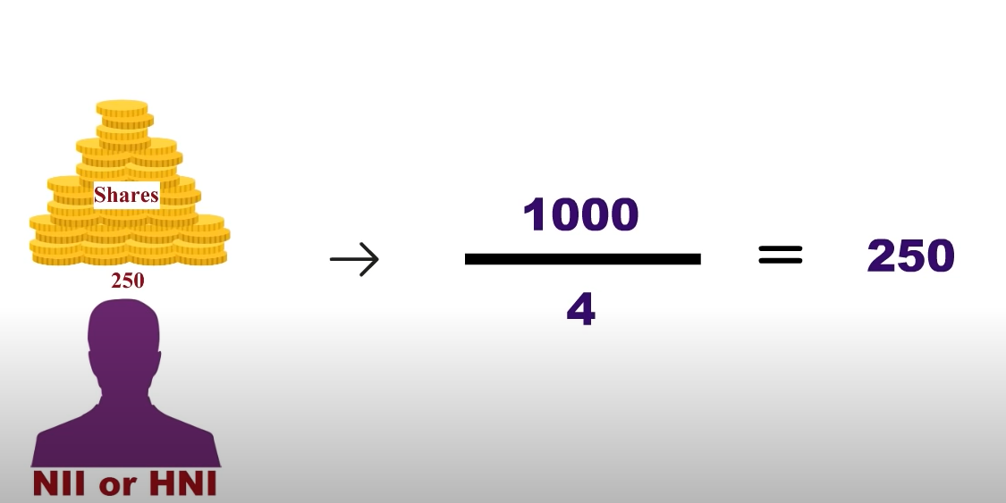
NII Case

Slide 20
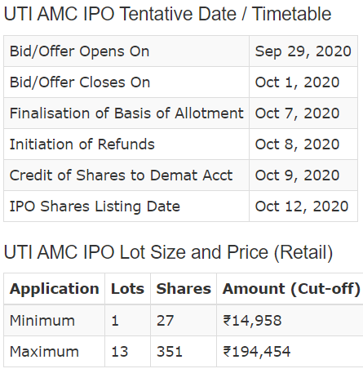

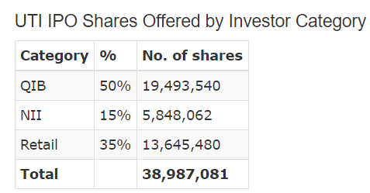
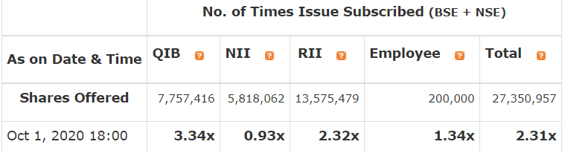
Registrar:
KF Infitech Private Limited

Slide 21
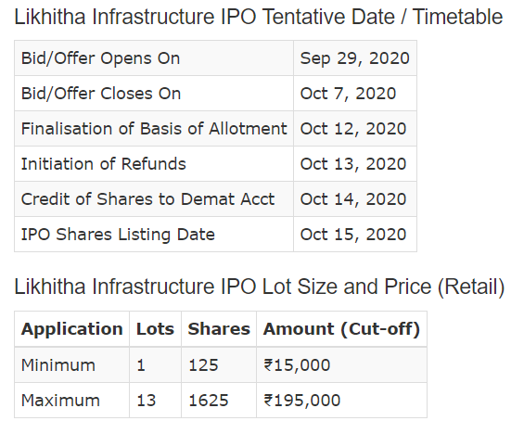

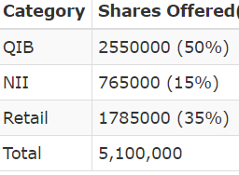
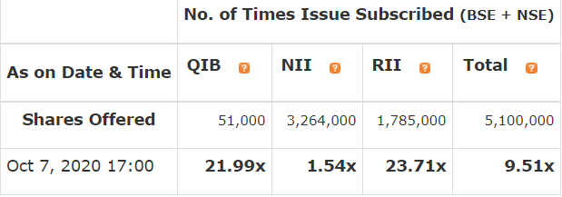
Registrar:
Big Share Services

Slide 22
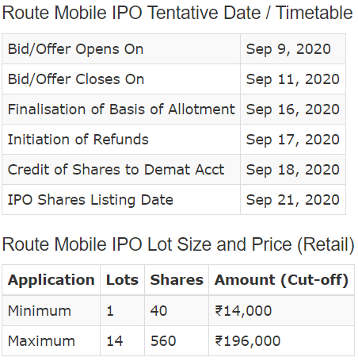

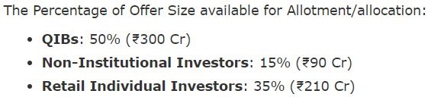
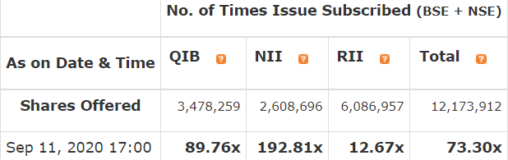
Registrar:
KF Infitech Private Limited

Slide 23

Role of Lead Manager in New Issue
Independent Financial Institution appointed by the company
LM should have a valid SEBI registration to be appointed
MoU to be signed with the issuing company. It should highlight mutual rights, liabilities and obligations relating to issue
Guidelines on the maximum limits of LMs by SEBI as laid down in Section 30 of SEBI Act, 1992:
Pre-Issue Role: Part 1
Pre-Issue Role: Part 2
Price Fixing
Stock Listing
Obligations of LMs in the life cycle of an IPO:
Abdul Ahadh

Slide 24
Pre-Issue Role: Part 1
Prepare Draft Offer Prospectus Document for IPO highlighting:
Background of the company
Promoters
Vision and Mission
Financial Performance of the company
File Draft Offer Prospectus with SEBI at least 21 days prior to filing of Offer Document with Registrar of Company(RoC) / Stock Exchanges (SEs)
SEBI may specify changes in the Draft Offer Document and the issuer of Lead Manager will carry out changes before filing with RoC/SEs
Advertisements/Road Shows for the IPO:
Advertisement in 1 English national newspaper, 1 Hindi national newspaper and 1 regional language newspaper inviting public comments to SEBI
Roadshows (series of meetings with potential investors and executives) held across different locations
IPO Goals and Targets
Forms of Issue
Future sales
Investment Projection of the company

Slide 25
Pre-Issue Role: Part 2
Submit the offer prospectus (document after changes made in Draft offer document) to SEs and RoC and get it approved
Issuer Company consults LMs as well as RoCs and SEs to finalise the date and duration of the IPO
Fixed Price/Price Band is determined with the help of Issuer company
Spread between floor and the cap should not be > 20% (Book Built IPO)
Price band if revised, should be widely disseminated across websites/press release/terminals/SEs and bidding period will be extended by 3 days
Modify Offer Prospectus with date & price band (the document is now called Red Herring Prospectus(RHP))
RHP and IPO application forms are printed and posted to syndicate members (commercial/investment banks registered with SEBI) which is further distributed to potential investors

Slide 26
Price Fixing
After the Public Issue closes for investors bidding, Lead Managers evaluate the final issue price (Cut-off price) based on the bids received
Lead Managers update the RHP with final issue price and send it to SEBI and Stock Exchanges
Stock Listing
Once all allocated shares are transferred to demat account of investors, Lead Manager with the help of Stock Exchange decides Issue Listing Date
Finally share of the issuer company gets listed in Stock Market

Slide 27
Summary: Life cycle of an IPO
(IPO Process Initialisation)
Appoinment of LM, RoC & Syndicate members
Stock Listing
Shares transfer to Investors
Prepare Draft Offer Prospectus
Processing IPO applications
Role of:
Lead Manager (LM)
Registrar of Company (RoC)
Filing with SEBI
Price Fixing
Pre-Marketing/ Roadshows
SEBI Clearance
Filing of Offer Document with RoC & SEs
Bidding for the Public Issue

